Slide 1
GAS LEVEL DETECTION AND AUTOMATIC BOOKING SYSTEM USING ARDUINO

Slide 2
INTRODUCTION
These days Liquefied Petroleum Gas(LPG) is widely used in many fields, especially in household purposes.
The leakage of LPG may lead to severe casualties. So there is a risk of increased accidents, with rise in its usage.
So it’s necessary to have a system which continuously monitors the LPG cylinder.
This project has an effective way of monitoring the gas quantity in the container and also to detect leakage to notify the user through GSM module and e-mail.

Slide 3
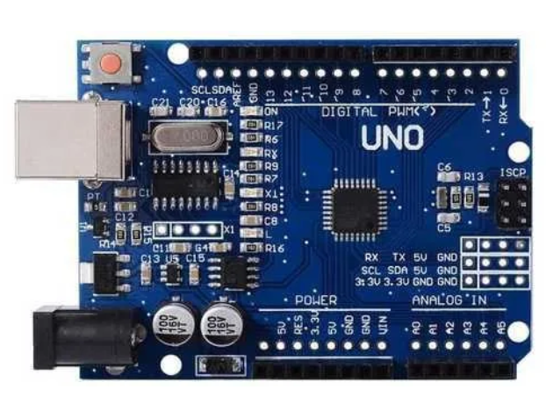
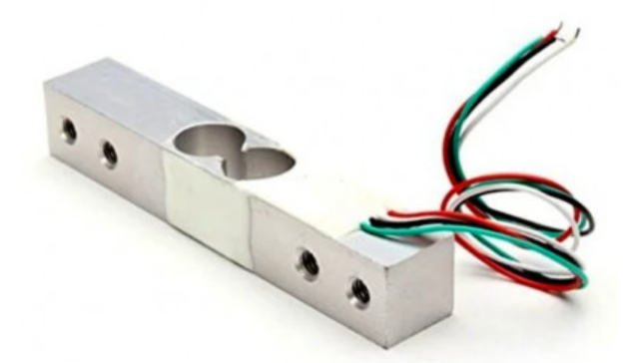
COMPONENTS
Arduino UNO : Arduino UNO is a microcontroller board based on the ATmega328P. It has 14 digital input/output pins (of which 6 can be used as PWM outputs), 6 analog inputs, a 16 MHz ceramic resonator, a USB connection, a power jack, an ICSP header and a reset button.
Load cell: Load cells are sensors that detect force (mass, torque, etc.). When force is applied to a load cell, it converts the force into an electrical signal. Load cells are also known as "load transducers," because they convert a load (force) into electrical signals.

Slide 4
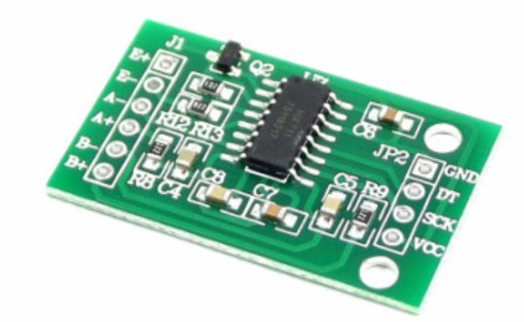
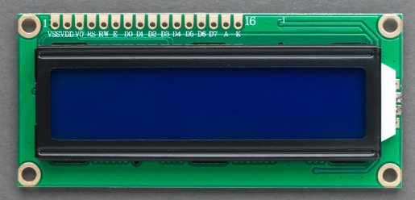
COMPONENTS
Load cell amplifier module(HX711): HX711 module is a Load Cell Amplifier breakout board that allows you to easily read load cells to measure weight. This module uses 24 high precision A/D converter chip HX711.
16x2 LCD display : LCD stands for Liquid Crystal Display . A 16X2 means it is used to display 16 characters per line . It consists of 16 pins(the first 14 pins are used to control the display and the last 2 pins are for backlighting). It don’t directly emit the light but uses backlight or reflector

Slide 5
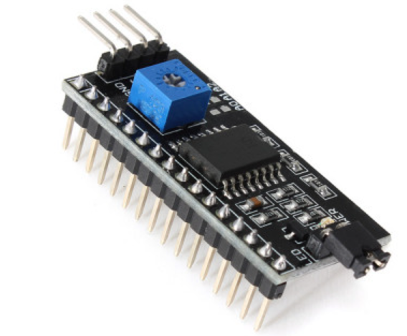
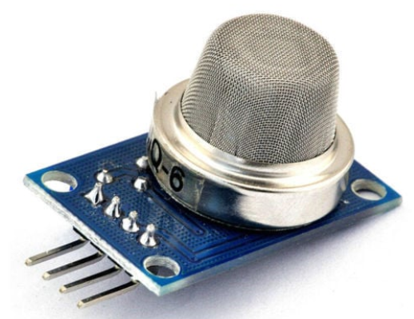
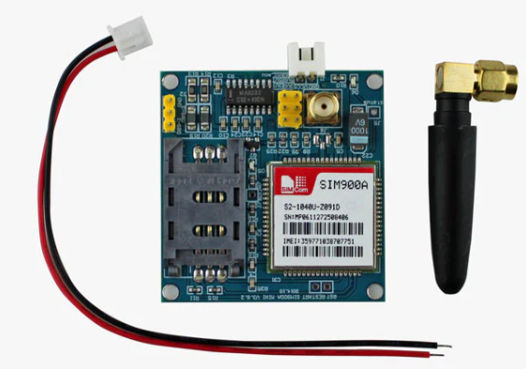
COMPONENTS
I2C module : It stands for inter integrated circuit. It is commonly used in embedded systems to communicate between microcontrollers and peripheral devices, such as sensors, memory chips, and other integrated circuits.
MQ2 gas sensor: The MQ2 (LPG Gas Sensor) is a simple-to-use liquefied petroleum gas (LPG) sensor. The MQ-2 is a smoke and combustible gas sensor from Winsen. It can detect flammable gas in a range of 300 - 10000ppm.
SIM900A GSM module : SIM900A Modem is built with Dual Band GSM/GPRS based SIM900A modem from SIMCOM. It works on frequencies 900/ 1800 MHz . SIM900A can search these two bands automatically. The frequency bands can also be set by AT Commands.

Slide 6
Block Diagram for level detection
I2C module
ARDUINO UNO
LCD Display
Load Cell
HX711 module

Slide 7
Block diagram for GAS LEAKAGE detection
GSM Module
Power supply
Arduino UNO
Gas sensor

Slide 8
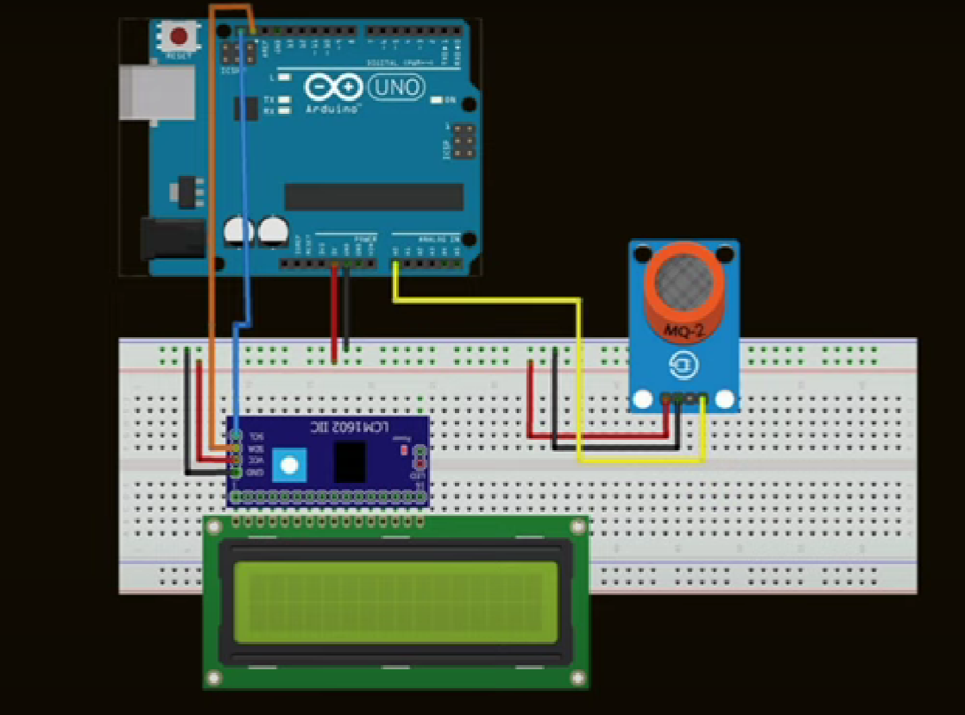
Circuit Diagram FOR GAS LEAKAGE DETECTION

Slide 9
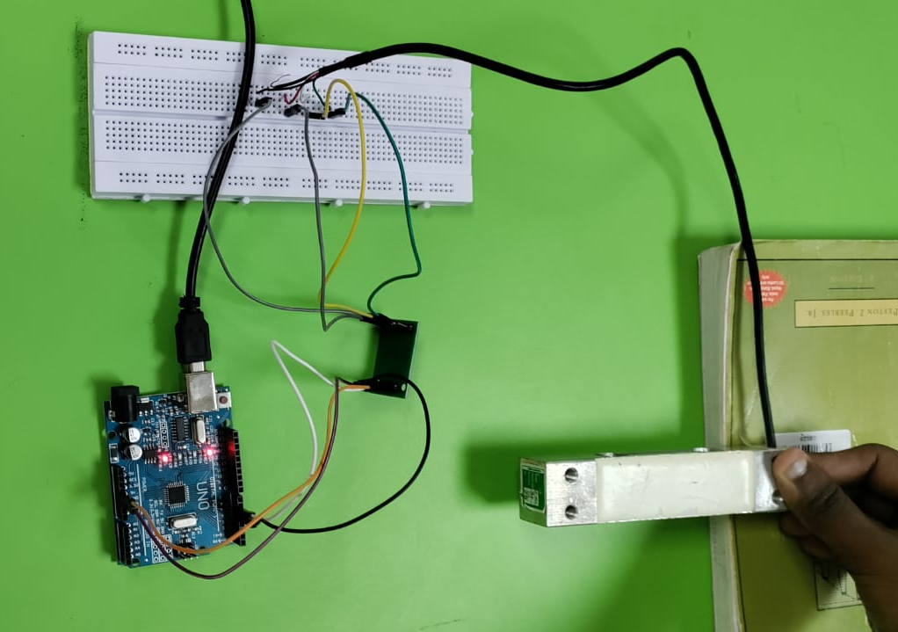
CONNECTIONS OF LOAD CELL
Arduino to load cell module:
5v – vcc
gnd – gnd
D4 – DT
D5- sck
load cell to HX711 module:
green - E+
white - E-
black - A-
red - A+

Slide 10
Working
The gas sensor detects other gases including smoke. When the gas is detected, the output of the sensor is sent to the Arduino UNO . When the weight measured using the load cell becomes critically low, the alert is sent to the user and a new LPG cylinder is booked.
When a match stick or incense stick is kept near the gas sensor that we have taken, then due to the smoke from the incense stick the message automatically comes to our mobile through the GSM Module application

Slide 11
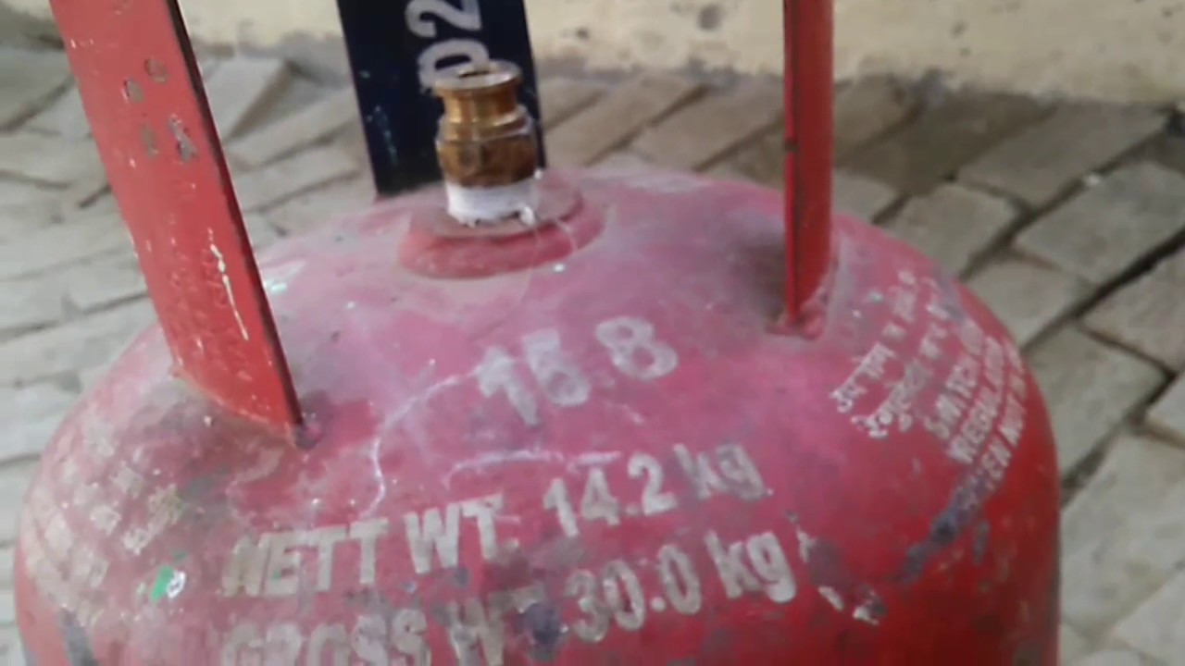

Slide 12
Advantages
SMS alerts aid in timely booking of a refill.
The proposed solution is easy to use and directly applicable to real life.
The solution is scalable and can be used at industrial level with minimal extra cost.
All the components are readily available.
The entire project uses low-cost parts.
The sensors used are highly accurate and have a quick response time.

Slide 13
Disadvantages
The calibration of the weighing scale has to be done every time the controller is reset.
Load cell is bulky in size.
The sensitivity of the Gas Sensor depends on humidity and temperature and is a little sensitive to smoke.
The proposed solution can only be used as an indicator or an alarming device, complete prevention of fires or hazards is not possible.
Complete automation of booking is not possible with the existing methods of LPG cylinder booking in some parts of India.

Slide 14
Applications
The setup can be directly used as a part of home automation.
The weighing scale designed to determine the level of LPG remaining in cylinder can also be used as a general-purpose weighing scale or in industrial applications like conveyor belts.
The leak detection and alert mechanism can be extended to be used in industries with a high incidence of gas leaks and in coal mines to prevent accidents

Slide 15
Result
The gas level is detected using load cell and the level is calculated using serial monitor of Arduino IDE
Smoke detection is done and message is sent to user using GSM Module
Finally an e-mail is sent to the user that the cylinder is booked by taking the credentials from the user

